Slide 1

MEDIA & THE PUBLIC
Week 3 Media trust
Ryan Wang
ryanyang@psu.edu

Slide 2

Stanford Cyber Policy Center Weekly Seminar

Slide 3
Key takeaways of Pew report
Greater portions of Republicans express distrust than express trust of 20 of the 30 sources asked about. Only seven outlets generate more trust than distrust among Republicans – including Fox News and the talk radio programs of hosts Sean Hannity and Rush Limbaugh.
Fox news phenomenon
Greater portions of Democrats express trust than express distrust in 22 of the 30 sources asked about. Only eight generate more distrust than trust – including Fox News, Sean Hannity and Rush Limbaugh.

Slide 4
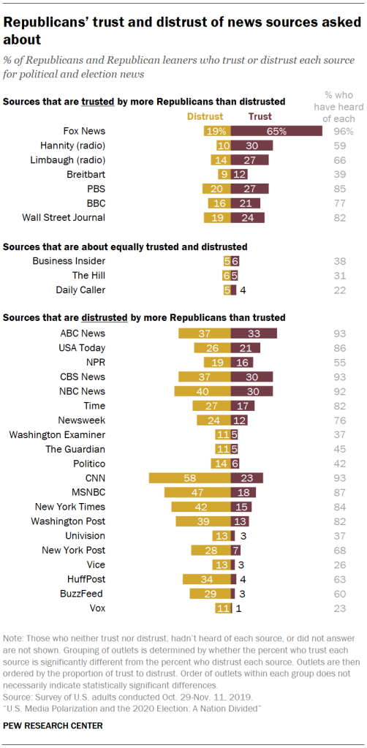
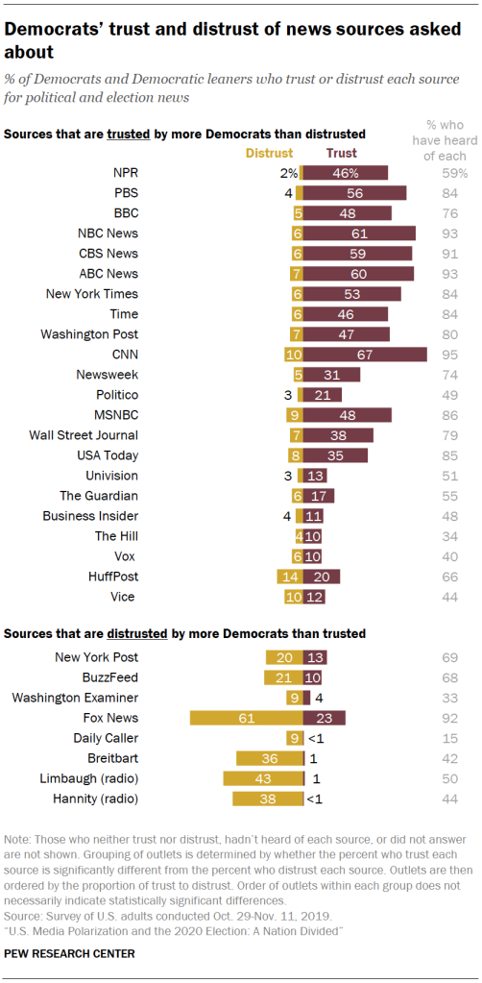

Slide 5
Key takeaways of Pew report
Partisan divides lead to one-sided audiences for many news outlets

Slide 6
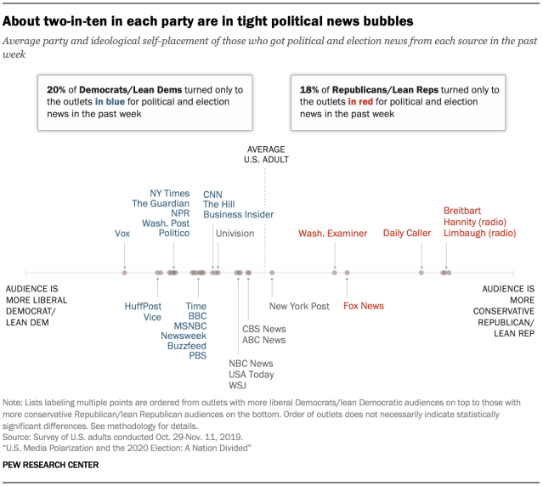

Slide 7
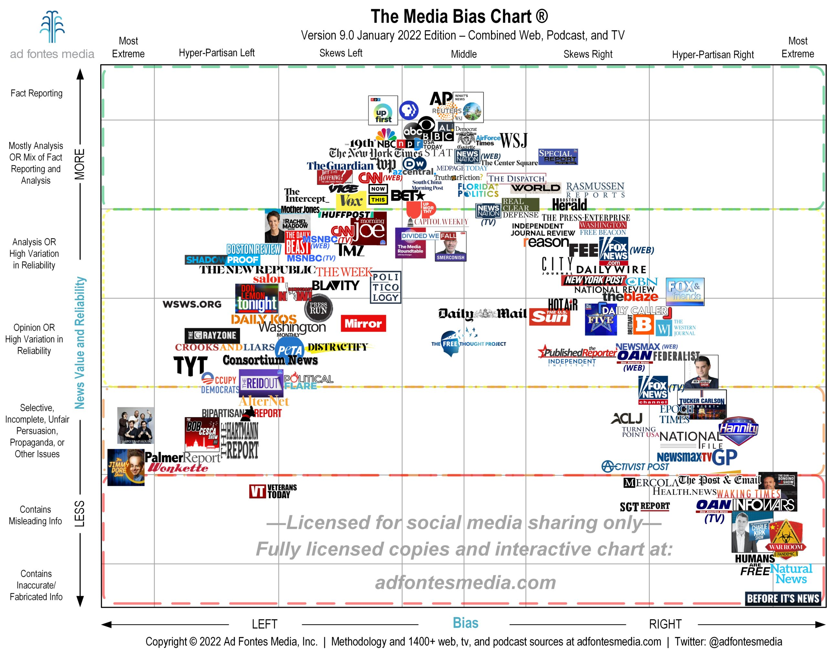
Source: Adfontesmedia

Slide 8
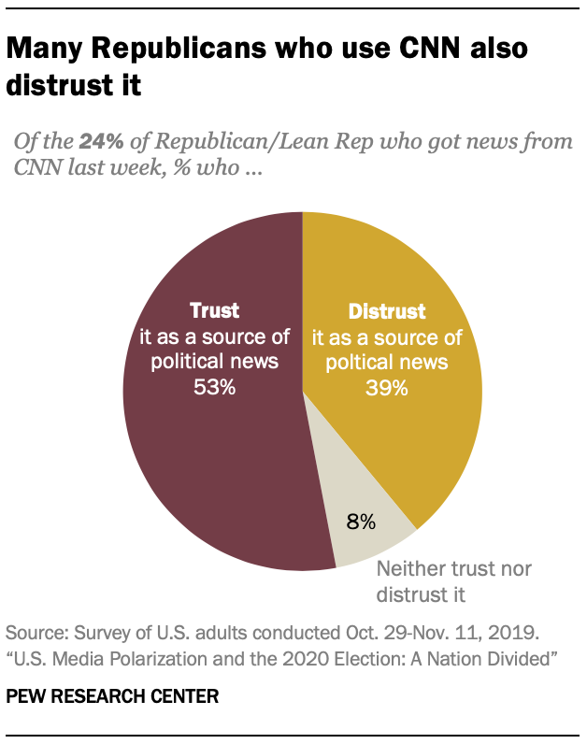
Key takeaways of Pew report
News consumption does NOT mean trust.

Slide 9
Key takeaways of Pew report
Partisan media divides have grown, largely driven by Republican distrust between 2014 and 2020

Slide 10
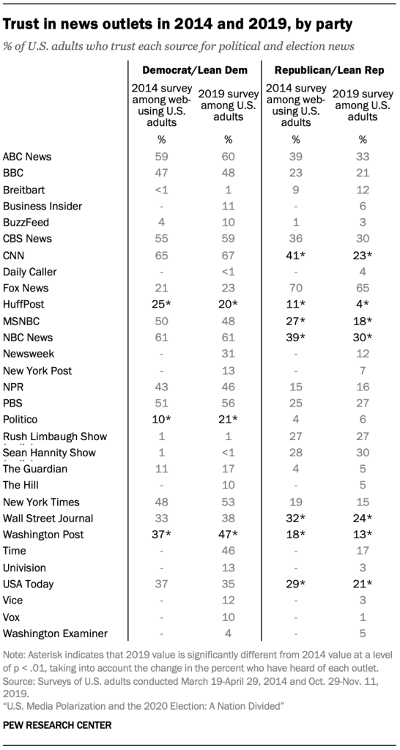
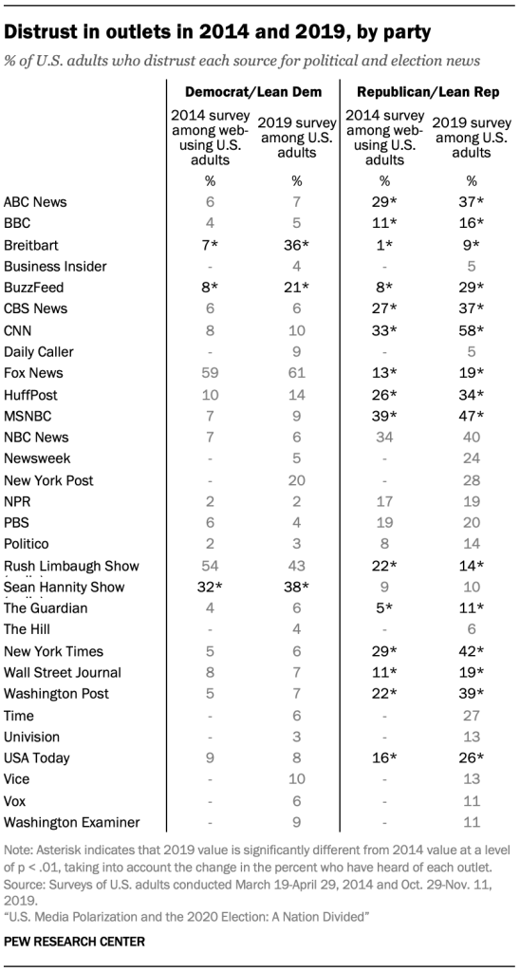

Slide 11
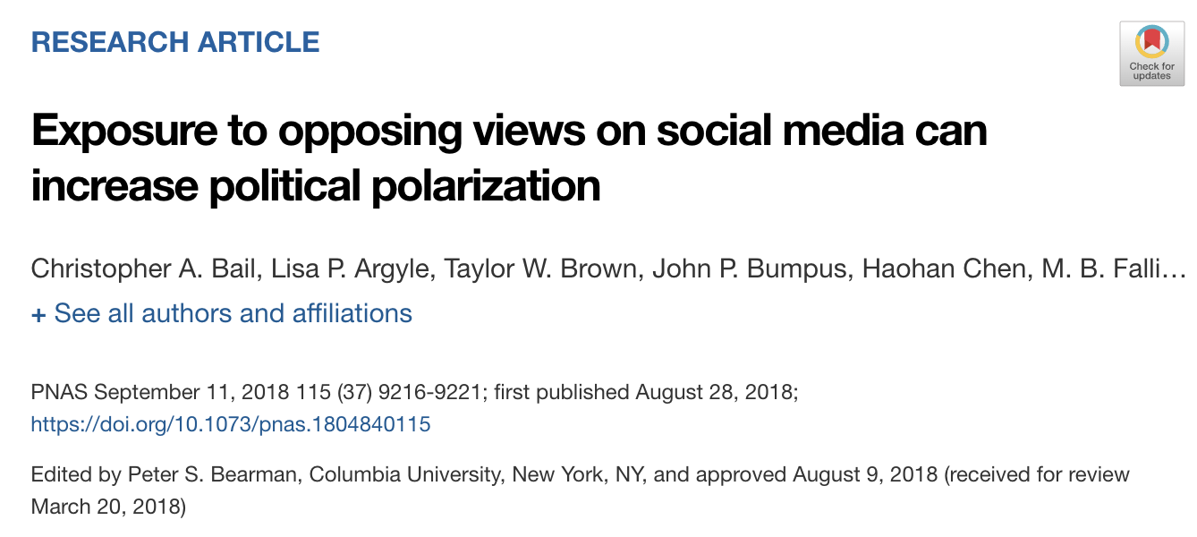
How do we fix it?
NEWS
Source: Bail et al. (2018)

Slide 12
Understanding the Public’s Animosity Toward News Media: Cynicism and Distrust as Related but Distinct Negative Media Perceptions (Markov & Min, 2021)

Slide 13
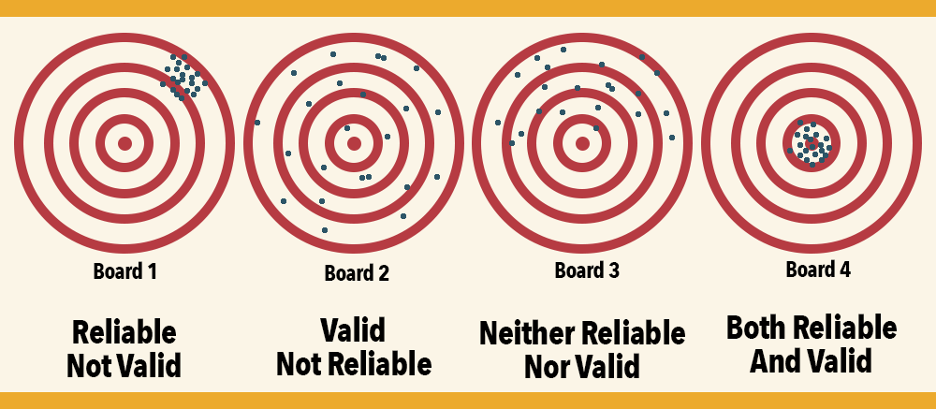
Background
Reliability

Slide 14
Background
Validity
Face validity
Does the content of the test appear to be suitable to its aims?
Content validity
Is the test fully representative of what it aims to measure?
Criterion validity: Do the results accurately measure the concrete outcome they are designed to measure?
Concurrent validity: the amount of agreement between two different assessments (compared to an established measurement)
Predictive validity: the ability of a measure to predict performance on another (related) outcome variable
Construct validity: Does the test measure the concept that it’s intended to measure?
Convergent validity: two measures that are supposed to be measuring the same construct and shows that they are related
Discriminant validity: two measures that are not supposed to be related are in fact, unrelated.

Slide 15
Background
Exploratory factor analysis
Measure underlying factor affecting the variables in a data structure without setting any predefined structure to the outcome (new scale)
Confirmatory factor analysis
Confirm predefined components that already explored
Implement for reconfirming the effects and possible relations existing between a set of predetermined factors and variables

Slide 16
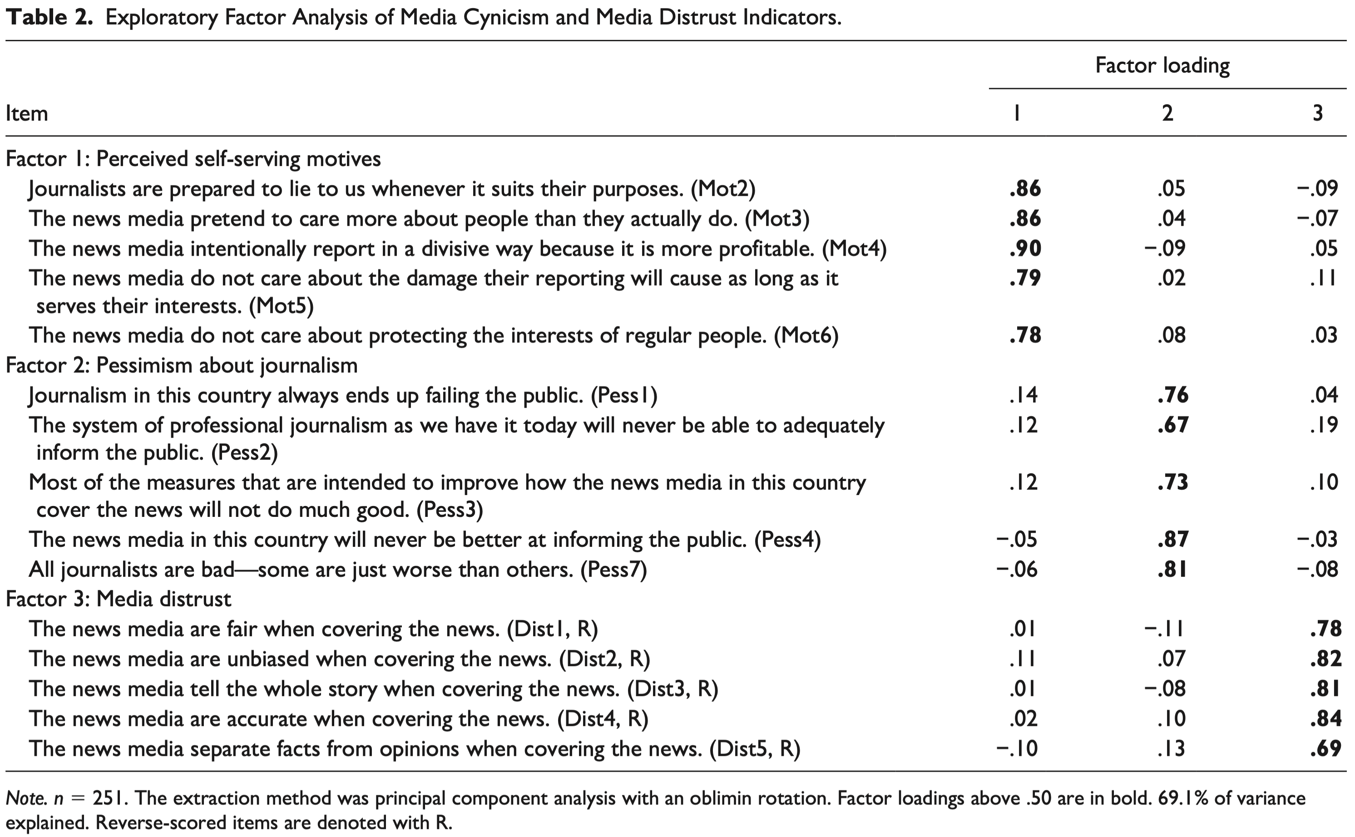
Background

Slide 17
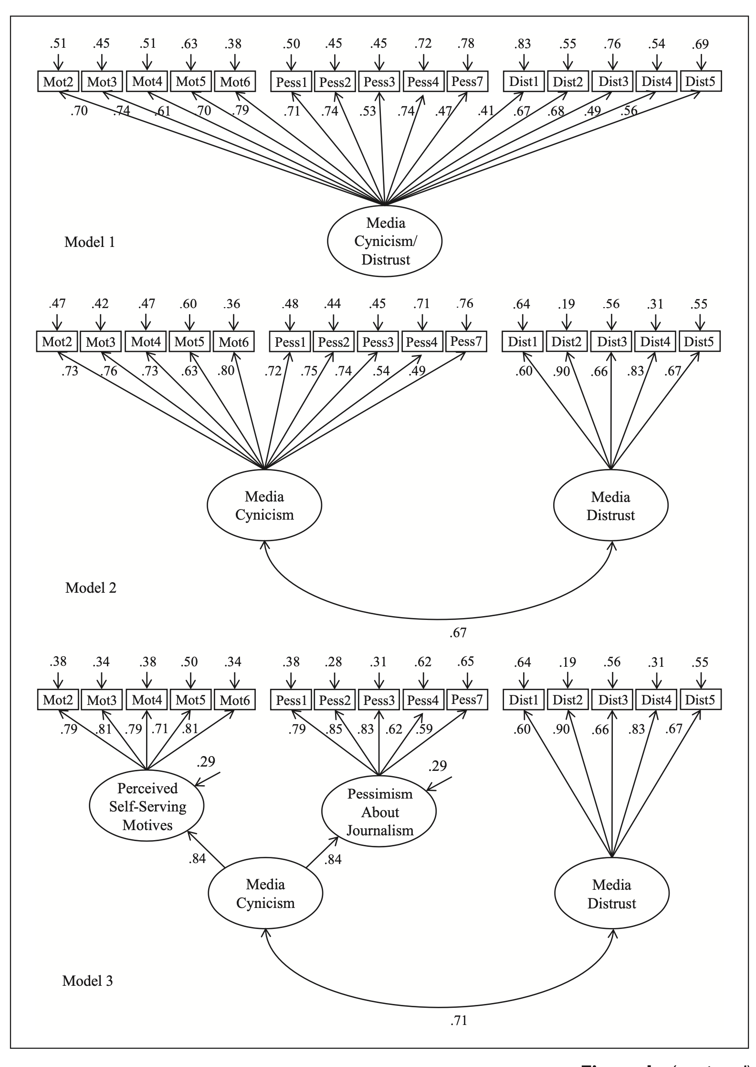
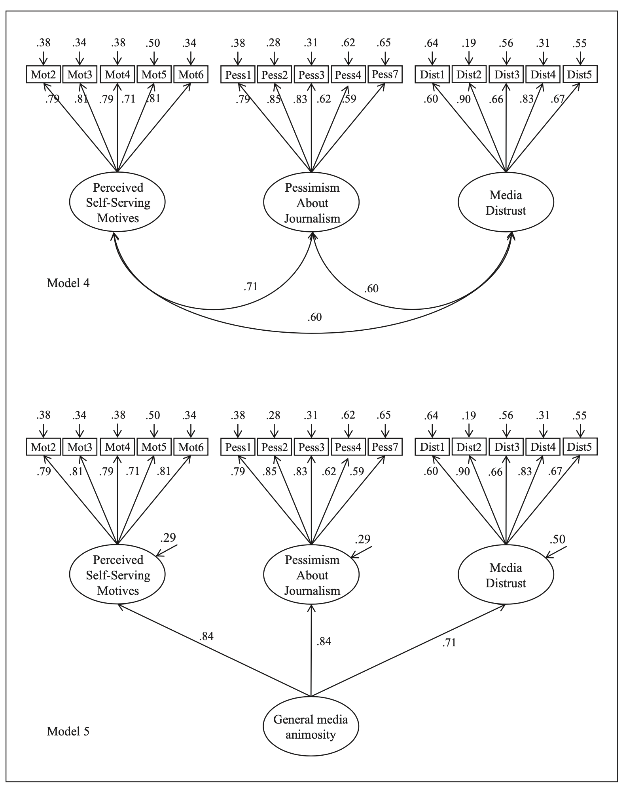
Background

Slide 18
Background

Slide 19
DON’T TRY TO READ EVERYTHING!
WHAT IS THE MAIN POINT OF THIS PAPER?
WHAT IS THE MAIN RESULT?
Dependent variable
Independent variable(s)
The relationship between IV(s) and DV
WHAT DATA ARE THEY USING?
WHAT METHOD DO THEY USE?
Measurement
Operationalization
How to they get to the result?

Slide 20
What are the main points of this paper?
Media cynicism
perceived self-serving motives of news media actors
pessimistic expectations of journalistic conduct
Media (dis)trust
Measurement items are framed in term of perceived outcomes (e.g., how objective, impartial, or complete the news reporting is)
Lack scrutinizing the criteria audiences use for such evaluations (e.g., how knowledgeable, skillful, honest, reliable, or principled the media are when it comes to performing the expected functions)

Slide 21
What are the main results (model fit)
RQ1: How can media cynicism be measured?
The final 10 items present a reliable and valid measure of media cynicism, which should be modeled as a second-order latent variable
RQ2: Can indicators of media distrust and media cynicism be empirically distinguished
The EFA and CFA results consistently showed that media distrust and media cynicism items always load better on their respective factors rather than on the same factor, providing initial evidence of discriminant validity

Slide 22
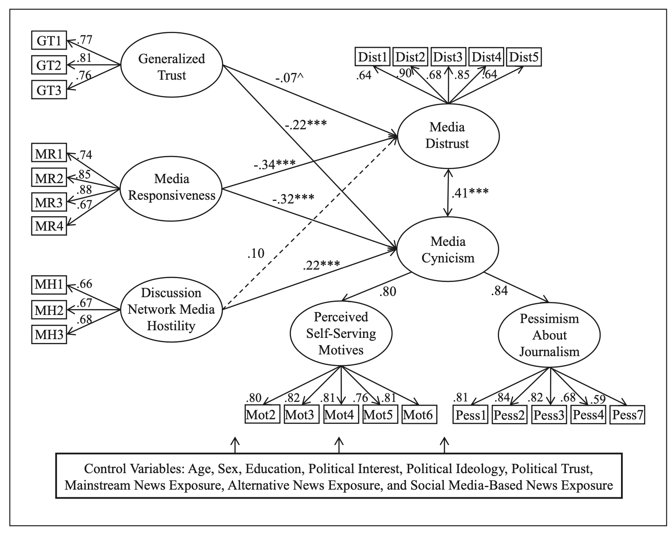
What are the main results (model fit)
RQ3: How do predictors of media cynicism differ from those of media distrust?

Slide 23
What are the main results (model fit)
RQ3: How do predictors of media cynicism differ from those of media distrust?
While generalized trust was a strong negative predictor of media cynicism, it was only marginally associated with media distrust (Low generalized trust indicated increased cynicism about media significantly more than did media distrust)
Media hostility in one’s discussion network was a significant predictor of media cynicism but not distrust.
Perceived media responsiveness was strongly associated with both media distrust and cynicism (The critical ratio for the difference between the estimates)

Slide 24
Key takeaways
Media distrust is NOT the same as media cynicism
Distrusting the media does not necessarily involve believing that newspersons have malicious intent or that the media are not capable of performing any better
Media cynicism cannot be fully explained by common indicators of media distrust
The instrument is not perfect though as the alternative measurement models cannot be completely ruled out
But indicators of media cynicism and distrust never load onto the same factor.
Future direction: is media distrust the opposite of media trust?

